Slide 1
DDS Analytics Talent Management
David Shaw
DDS 6306

Slide 2
Introduction
Concerns
Worker attrition
Monthly salary

Slide 3
Data Cleaning
Missing value imputation?
None detected
Normality requirements
Log transformations
KNN limitations
Recoding variables
Split into test and train sets

Slide 4
Predicting Attrition
Approaches:
Stepwise logistic regression
K-Nearest Neighbors
Logistic Regression
Assumptions
KNN: data in feature space
Requires recoding of categorical variables
Logistic regression: multivariate normal distribution, independence

Slide 5
Stepwise Logistic Regression
Use automatic selection techniques to perform data reduction
Fit forward, backward, and stepwise models
Find jointly significant variables, at a Bonferroni-corrected .05 significance level

Slide 6
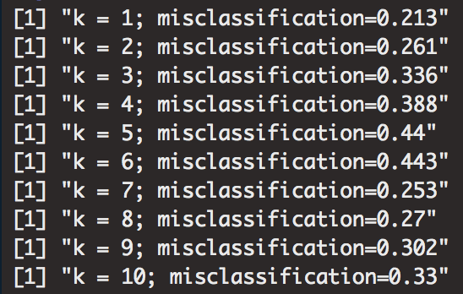
K Nearest Neighbors
Starting with the jointly significant variables from stepwise, fit a KNN clustering model
Test various k’s
Elbow Plot
Error rates by k

Slide 7
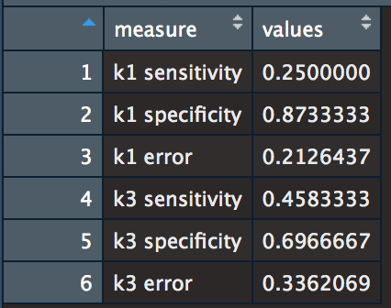
KNN Accuracy
Fit statistics:
Sensitivity - rate of capturing true positives
Specificity - rate of capturing true negatives
Error rate – percentage incorrect
Poor accuracy – neither model can capture 50%+ of both positives and negatives

Slide 8
Logistic Regression
Use selected variables to run a custom logistic regression model
Best predictors:
Total years worked
Overtime-exempt status
Years since last promotion

Slide 9
Logistic Regression
Use selected variables to run a custom logistic regression model
Best predictors:
Total years worked
Overtime-exempt status
Years since last promotion

Slide 10
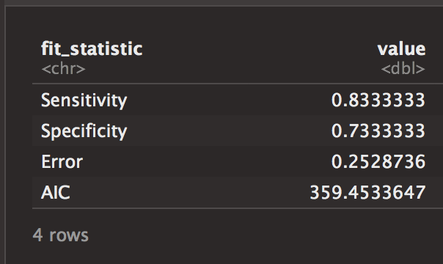
Logistic Diagnostics
Fit Statistics
Quantile-quantile plot
ROC Curve

Slide 11
Predicting Monthly Income
Same technique used for classifying attrition – stepwise regression to find joint predictors, use as starting point to fit linear regression model
Assumptions:
Independence
Equal variance
Normal distribution of residuals about 0

Slide 12
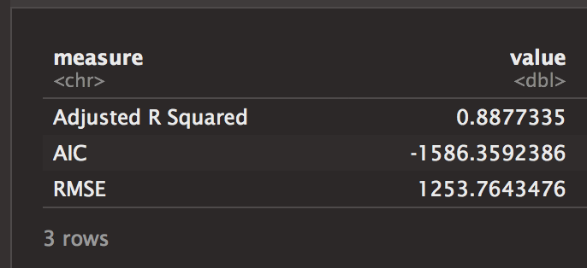
Linear Regression Output
Fit model using jointly significant variables – only 3
Job role, total working years, job level
Strong fit statistics
Assumptions met
Fit Statistics
Residuals

Slide 13
Conclusion
Attrition best predicted by logistic regression
Most significant variables: total working years (logged), overtime-exempt status, years since last promotion
Longer tenured, non-overtime, recently promoted employees less likely to leave
Monthly income best predicted by linear regression
total working years (logged), job role, job level
longer tenured, higher level employees tend to make more
Monthly Income by Role

